Slide 1
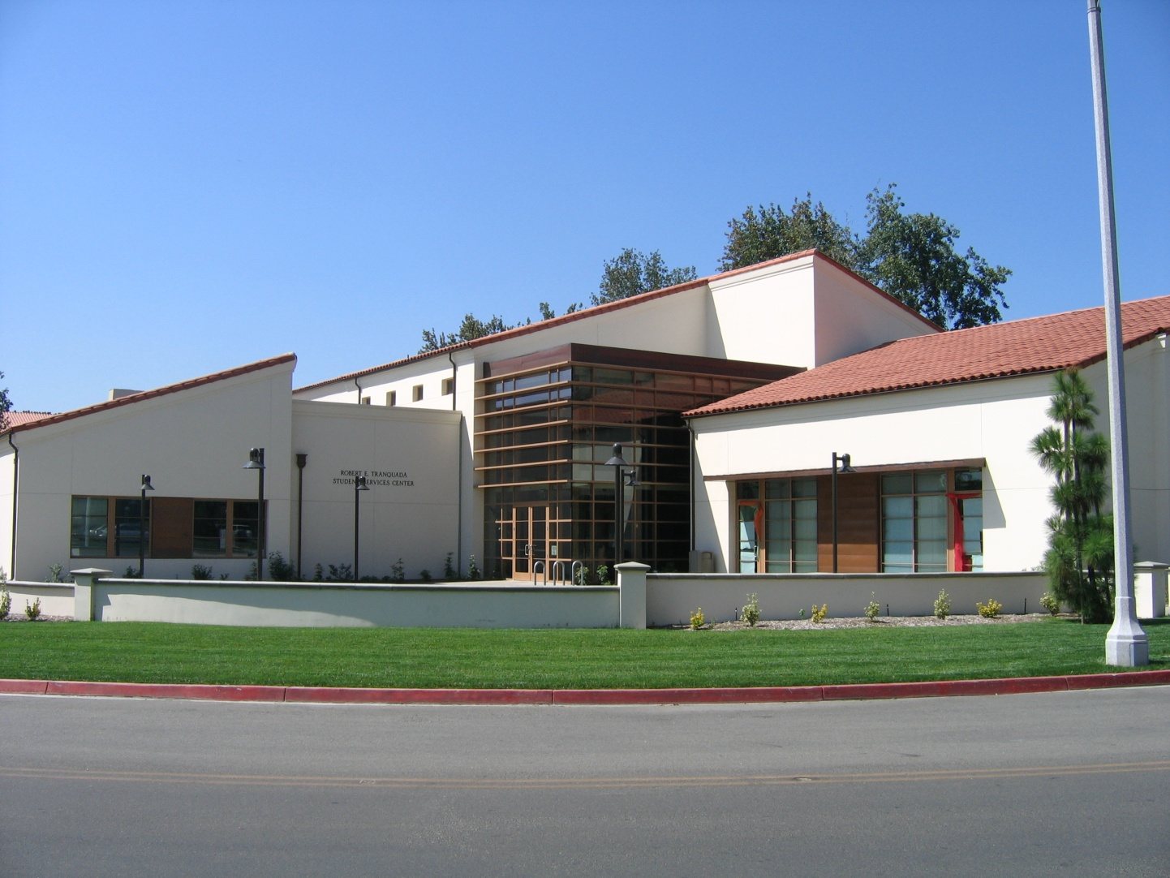
Introduction to Student Health Services
Committed to promoting the physical health and wellness of all students at The Claremont Colleges.
Fall 2023

Slide 2
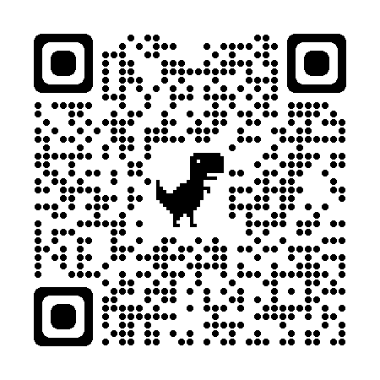
The Claremont College Services
(TCCS)
https://services.claremont.edu/student-services/
Notes:
SHS is one of a suite of student services offered by TCCS for the claremont colleges

Slide 3
Introduction to
Student Health Services (SHS)
SHS founded in 1952 with a gift by Dr. George Baxter, operated by TCCS
Services are available for undergraduate students enrolled and taking classes at the 5Cs (Pomona, Scripps, Harvey Mudd, Claremont McKenna, and Pitzer)
Located on the First Floor, Tranquada Building
757 College Way (across from the Library)
Multidisciplinary team
Nurses
Nurse Practitioners
Physicians
Medical Assistants
Receptionists
Medical records & student accounts specialists
Clinical & operational leaders

Slide 4
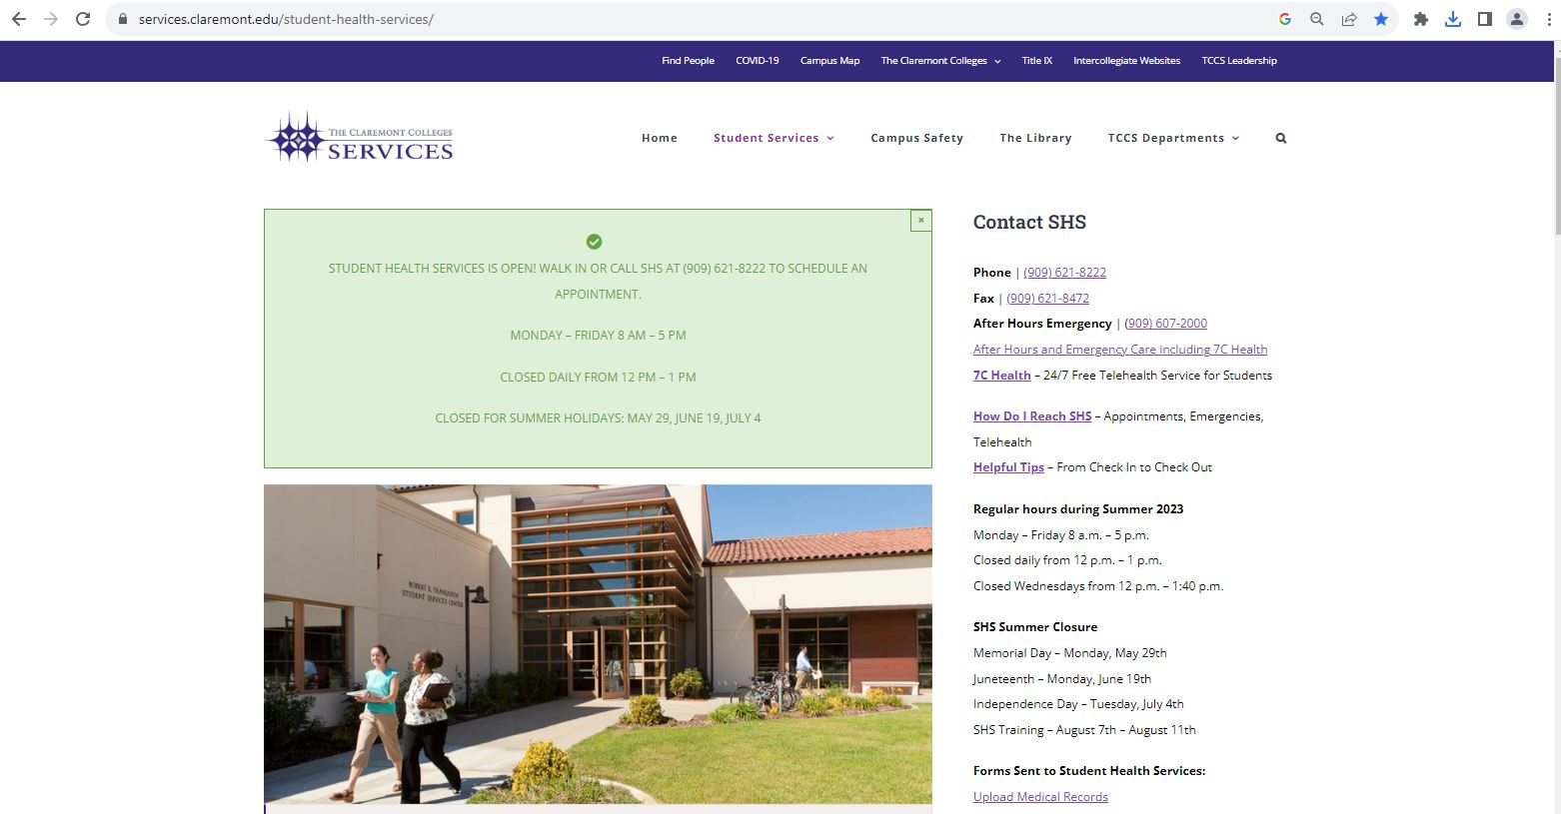
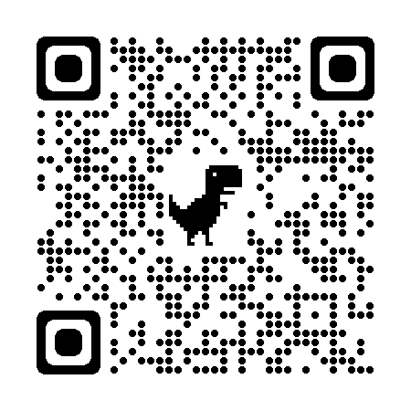
https://services.claremont.edu/student-health-services/

Slide 5
Introduction to SHS
Services at SHS
All medical information is confidential and cannot be disclosed without your consent.
The only exceptions are:
if you pose a danger to yourself or to others or
there is required reporting to the state of California or local health departments.
Same day urgent visits
For Illness or injuries
SHS stocks frequently used medications so you can skip that trip to the pharmacy!
General Medical Visits
For routine care and managing your medical conditions
SHS offers visits for sexual & reproductive health services like contraception, STI testing & treatment, PEP & PrEP, hormone therapy and more!
Specialty visits on campus such as:
Physicals for sports & study abroad
Discreet testing for HIV and pregnancy
Find the full list of services and fee schedules on our website:
https://services.claremont.edu/student-health-services/

Slide 6
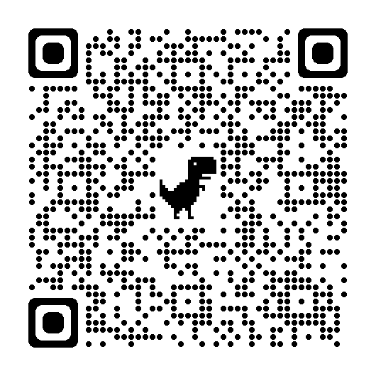
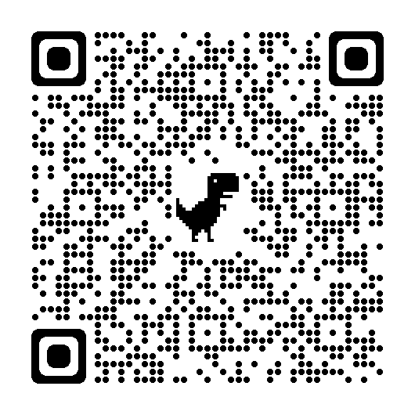
Introduction to SHS
Fee Schedules
Office Charges
(visits, immunizations
radiology,
procedures, etc)
Supplies
(ace wraps, braces, cold & hot packs, crutches, etc)
Labs
(Blood counts,
electrolyte checks, strep swabs, etc)
Formulary
( medications
such as antibiotics, contraception,
hormones)

Slide 7
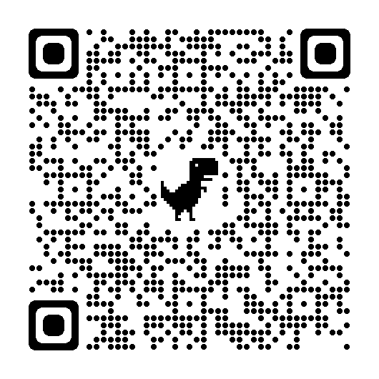
Introduction to SHS
Online Health Portal
SHS offers an online portal thru our electronic medical record
In the portal you can:
Receive test results
Review, update, and print immunization records
Exchange secure messages with health center staff
Upload medical records
View your financial account summary
Online booking (Arriving this Fall!)
Schedule, view, and cancel visits from wherever you are … coming soon!
And more!
Online Health Portal
https://shshealthportal.cuc.claremont.edu

Slide 8
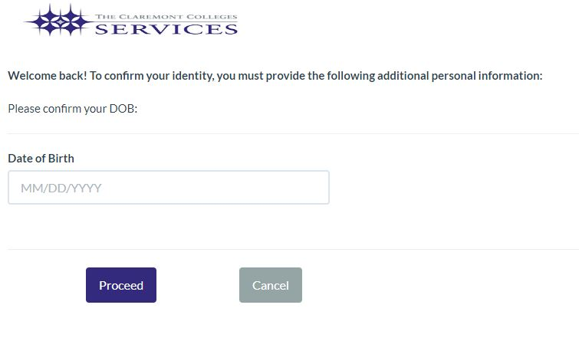
<Insert Student Portal Screenshot>
To protect your information, you will also need to authenticate with Duo!
https://shshealthportal.cuc.claremont.edu

Slide 9
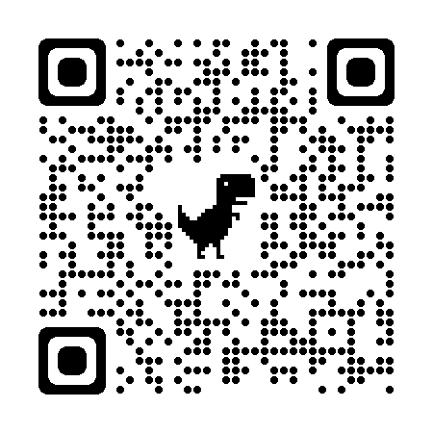
From Check-in to Check-out
Helpful Tips to Making the Most of Your Visit to SHS

Slide 14
Intro to SHS
Important Reminders
Don’t forget …
To bring your current student ID
It costs $15 if you miss your appointment so please cancel at least 2 hours in advance
If you are running behind, late arrivals may be rescheduled to allow your fellow students visits to start on time
Our website has this info and much more:
https://services.claremont.edu/student-health-services/

Slide 15
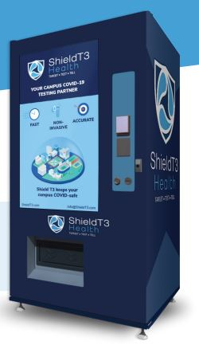
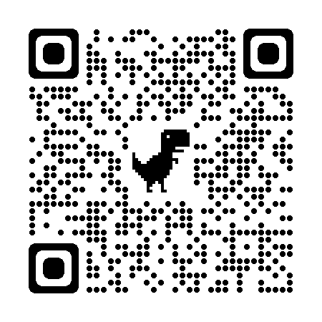
COVID Services on Campus
Last updated 7/28/23
Routine asymptomatic screening can be done by saliva PCR test available without a visit in vending machines on campus
Symptomatic testing is offered as part of a provider visit
SHS offers rapid antigen and PCR testing
Contact Tracing is required and conducted on campus
COVID-19 vaccinations (including boosters, when indicated/available)
Requirements vary per school
https://services.claremont.edu/covid/vending-machines/

Slide 16
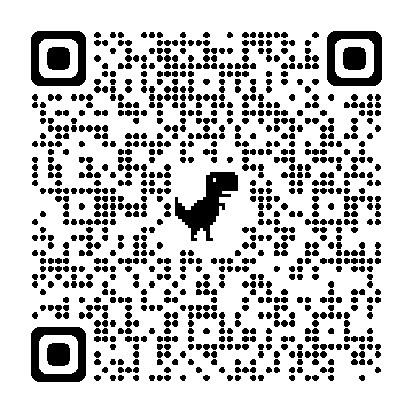
Introduction to SHS
Emergencies and on-demand care
For all Medical Emergencies, contact Campus Safety at (909)607-2000
Urgent care and emergency medical services can be found online using the QR code to the right
SHS partners with TimelyCare to provide 24/7 on demand and scheduled medical & mental health visits
Acute care and emergency care resources near Claremont, CA

Slide 17
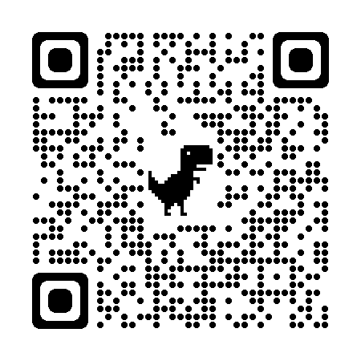
Use this QR code to register or download the App!
Remember to use your college email to sign up!

Slide 18
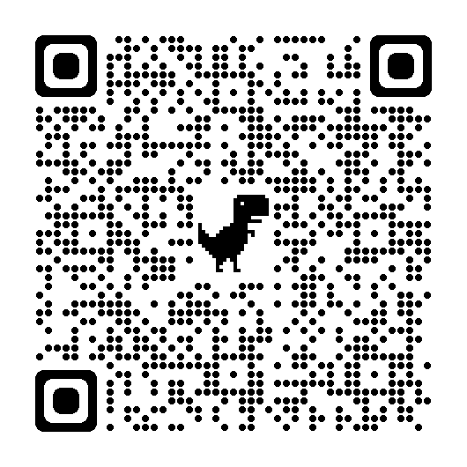

Slide 19
Thank you for your attention!

