Slide 1
Managing Test Anxiety
Melissa McMullin, Psy.D.
MCAPS Workshop
(909)621-8202
Melissa_McMullin@cuc.claremont.edu

Slide 2
What is test anxiety?
Physical symptoms
Feelings
Thoughts
Behaviors

Slide 3
Do you have test anxiety?
Can you recall the information you forget when you leave the exam?
Are you stressed or anxious during the test?

Slide 4
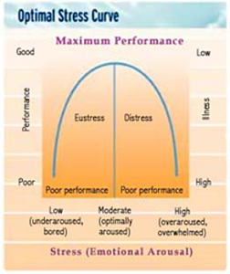
Why do we have anxiety?

Slide 5
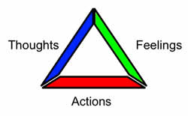
What can you do about anxiety?

Slide 6
Alter your actions
Do something else during the exam.
Practice guided imagery.
Engage in progressive relaxation.
Breathe.
Change how you take the exam.
Change where you take the exam.

Slide 7
Before the Exam
Create a study plan.
Rehearse taking the test (practice exams and imaginary exams).
Study in the exam space.
Plan out what you need for the test.
Plan time for yourself away from studying.
DON’T study at least 1 hour prior to the exam.

Slide 8
During the exam
Write down any information you are apt to forget when you first get the exam.
Preview the exam.
Read all of the instructions.
Plan a timed strategy for the exam.
Prioritize high point items.
Answer what you know first.
Then answer what you half know.
Then answer the tough questions.
Don’t forget to use every tool available to you (e.g. calculator, periodic table, etc.).

Slide 9
If the anxiety starts to creep in…
Think about the exam as a conversation between you and your professor.
Revisit your imaginary exam.
Breathe.
Sharpen your pencil.
Move on to another question.
Substitute simple language for complex terms.

Slide 10
Change your thoughts
Identify your thoughts
Evaluate your thoughts
Are my thoughts accurate and or factual?
Respond and challenge your thoughts
Relax

Slide 11
Challenging your thoughts
What is the evidence that the thought(s) is/are true? Not true?
Is there an alternative explanation?
What’s the worst that could happen?
Could I live through it?
What’s the best that can happen?
What’s the most realistic outcome?
What are the consequences of adhering to the distorted thinking?
What would happen if I changed my thinking?
If (friend’s name) were in this situation what would I tell him/her?

